Slide 1

Unravelling the Mysteries of Resurrection Plants using R
Dr Astrid Radermacher
Plant Stress Lab
Molecular and Cell Biology
University of Cape Town
Notes:
Xeropyhta schlechteri is a resurrection plant. Resurrection plants are able to withstand complete desiccation of their vegetative tissues, to less than 5% relative water content, and recover within hours of receiving water.
There has been a lot of work on how RPs are able to withstand desiccation, but not a lot of work done on how they repress programmed cell death during this process. This project compared senescent and non-senescent

Slide 2


Slide 3
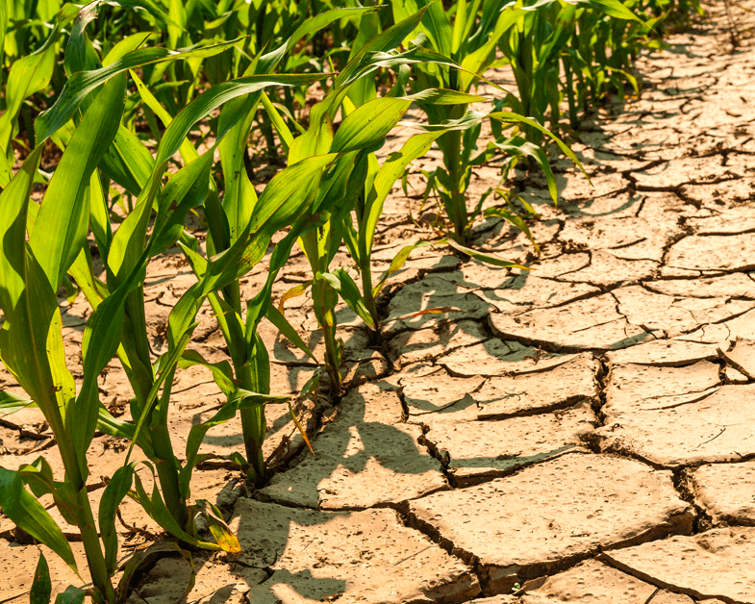

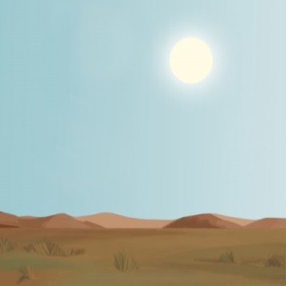
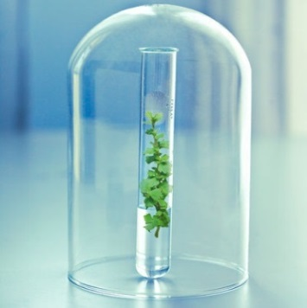

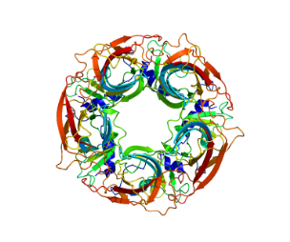
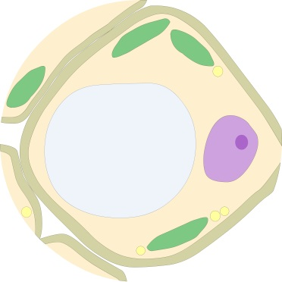
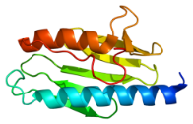
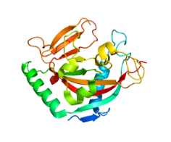
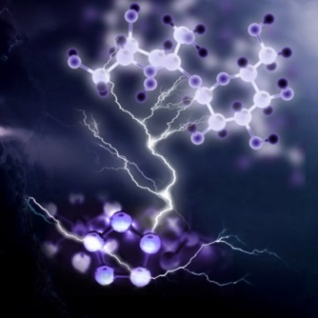

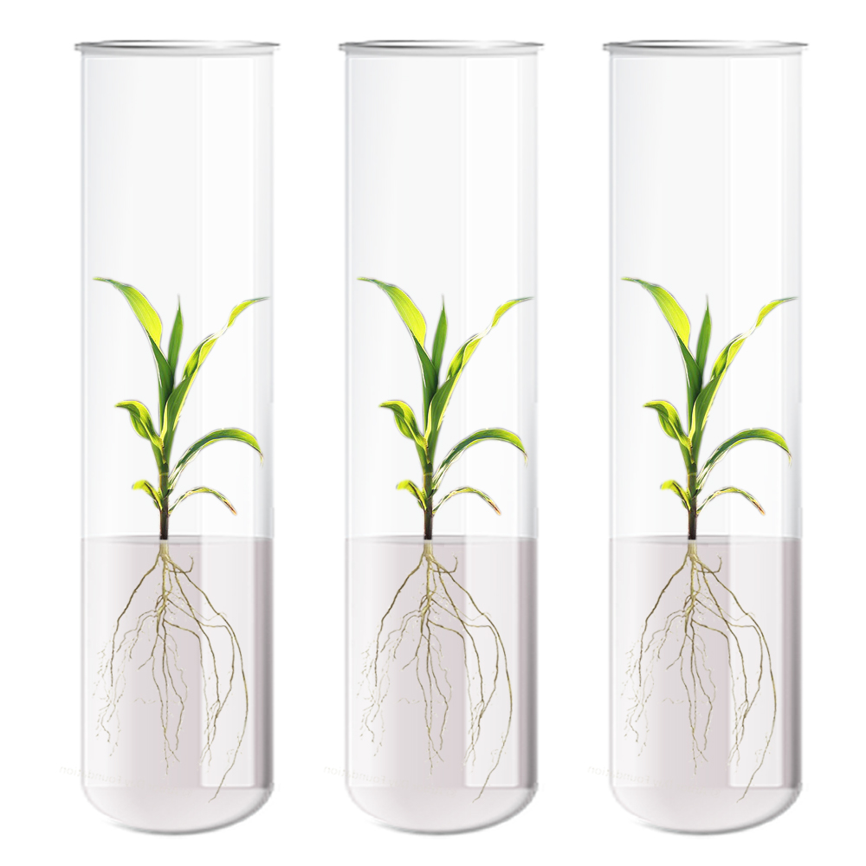
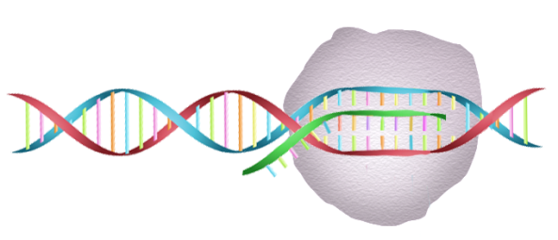
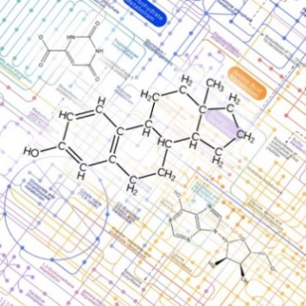
SYSTEMS
BIOLOGY
APPROACH
ECOPHYSIOLOGY
PHYSIOLOGY
GENOME
CELL STRUCTURE
PROTEOME
BIOCHEMISTRY
BIOTECHNOLOGY
TRANSCRIPTOME
METABOLOME
Ribosome

Slide 4
Ultimate Goal:
Engineering of crops that use water efficiently, are more drought stress tolerant while maintaining yields sufficient to ensure food security

Slide 5
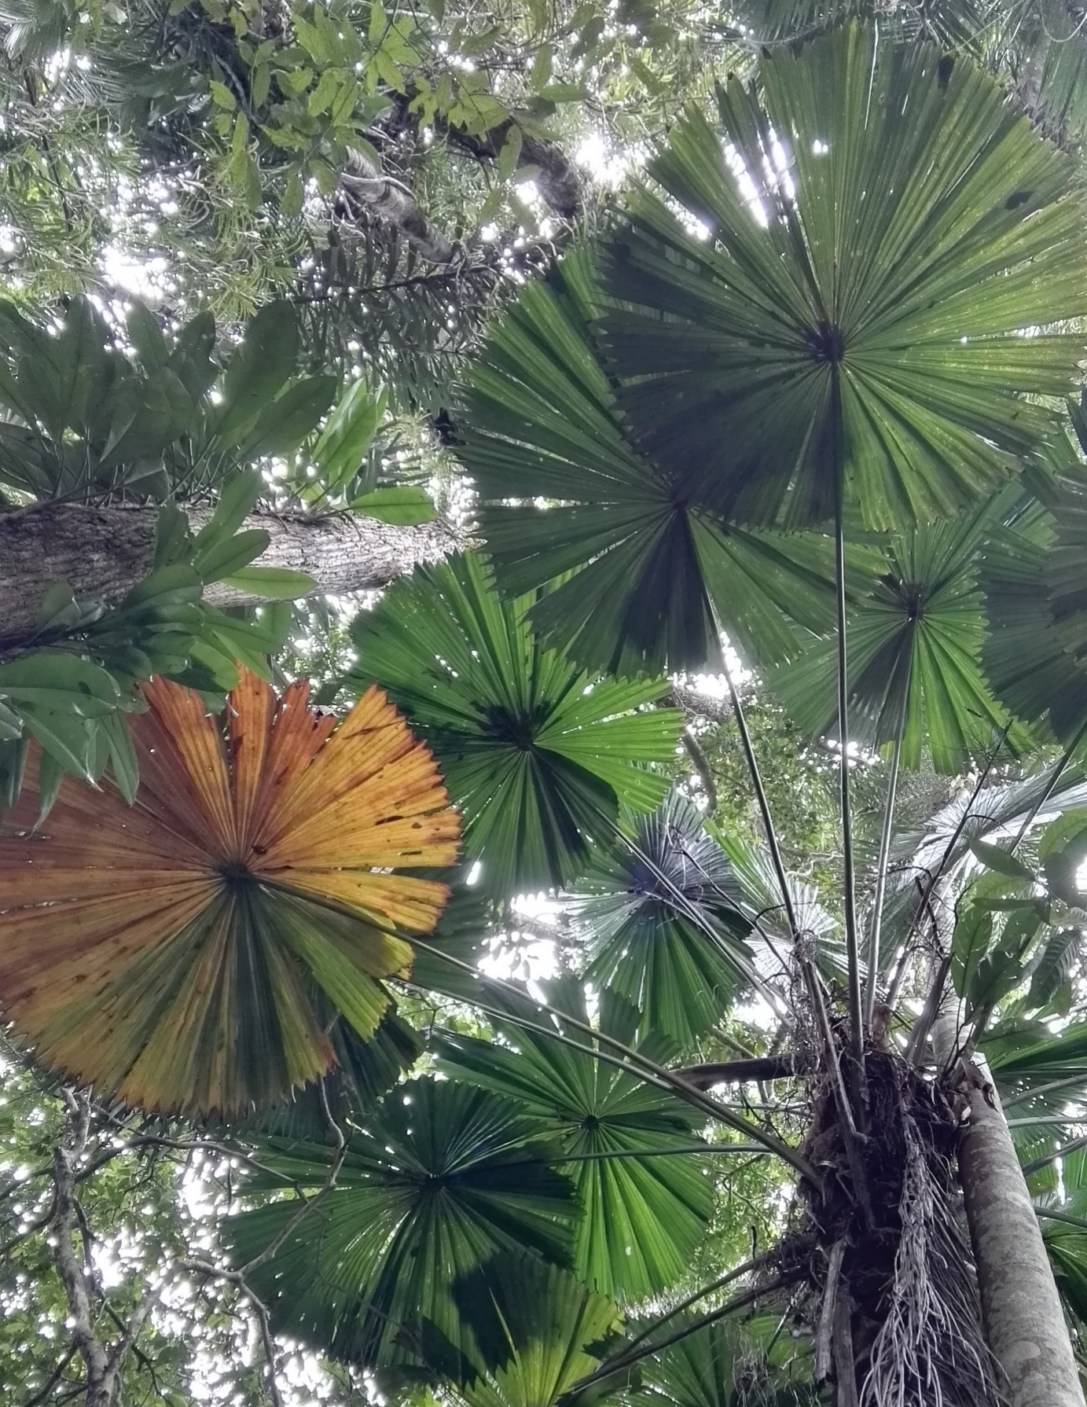
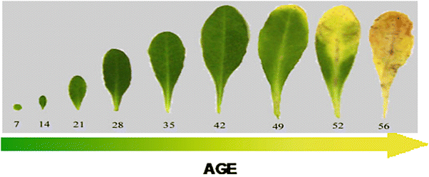
Aging
Abiotic/biotic stress
Senescence
Nutrient redistribution
How is this natural process, supposedly hardwired, switched off in resurrection plants?
Notes:
In non-resurrection plant species, surviving water deficit stress involves upregulation of dehydration tolerance genes that enable water retention. Senescence occurs when water loss becomes severe - the plant sacrifices tissues in order to reduce canopy size and transpiration, while remobilising nutrients to younger tissues or reproductive organs.
It is a controlled shutdown and redistribution process.

Slide 6
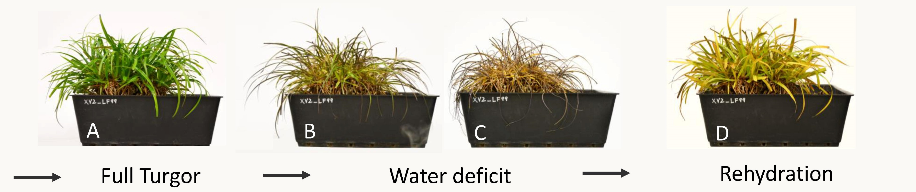
Xerophyta schlechteri: a monocotyledonous resurrection plant and model for understanding improved drought tolerance in cereals.
We know a lot about how it is able to survive desiccation, but how does X.schlechteri prevent expression of genes related to programmed cell death?
Notes:
How PCD is modulated in plants is highly variable depending on tissue type, developmental stage and stressor. In the context of drought, the oldest tissues generally senesce first, redistributing nutrients towards the younger parts of the plant. This reduces the canopy size and transpiration, which requires water. Redistribution of nutrients towards reproductive structures is also common, which allows plants to quickly reproduce before they kick the bucket. Of course, resurrection plants do things a little differently. When my study species, Xerophyta schlechteri, dries down, most of the tissues enter a quiescent state, and energy within cells goes towards tolerance mechanisms. There is limited death at the apex of leaves, but most of the tissue is viable upon rehydration and is able to recover. So how do they repress this senescence response observed in so many other plant species in the bulk of their tissues?

Slide 7
Research Questions:
When during drying are senescence processes initiated?
2. How is this process regulated on the gene expression level?

Slide 8
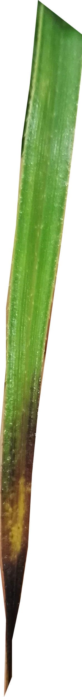


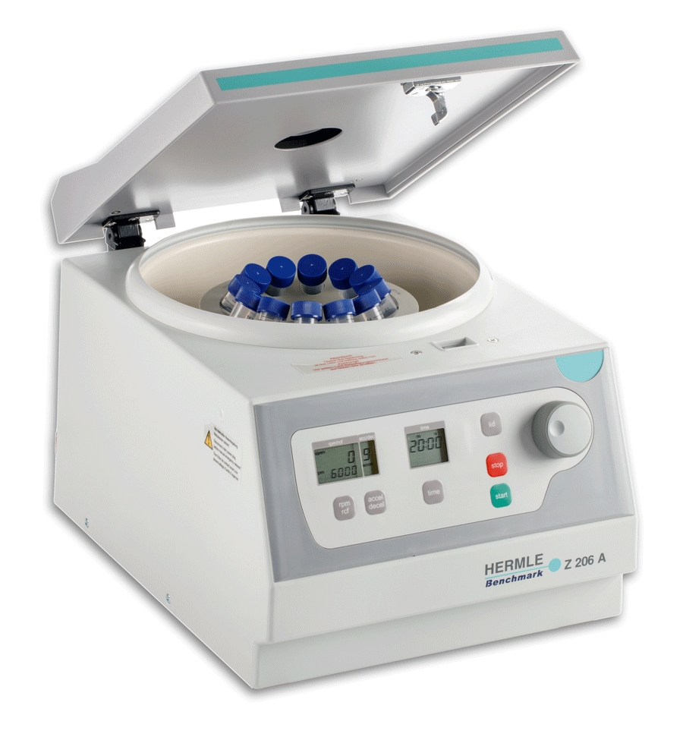
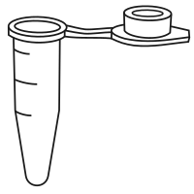
Experimental design
Withhold water and sample for RNA and water content – store tissue at -80°C
Dissect tissue from sampling points of interest
Grind in liquid Nitrogen
Extract in Trizol
Centrifuge to phase separate
Notes:
Basically read slide points

Slide 9
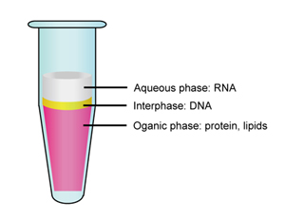
RNA-Seq data: TPM (transcripts per million) values are compared. This is the number of transcripts that map to a gene, divided by the length of the gene and normalized to a scaling factor (specific to the sequencing run).
Differential expression: When genes are significantly differentially accumulated/diminished in one condition compared to another (Fisher’s Exact test, corr pval < 0.05), expressed as log2 foldchange.
Genes
Expressed genes (transcripts)
Quantified and compared between genes and conditions

Slide 10

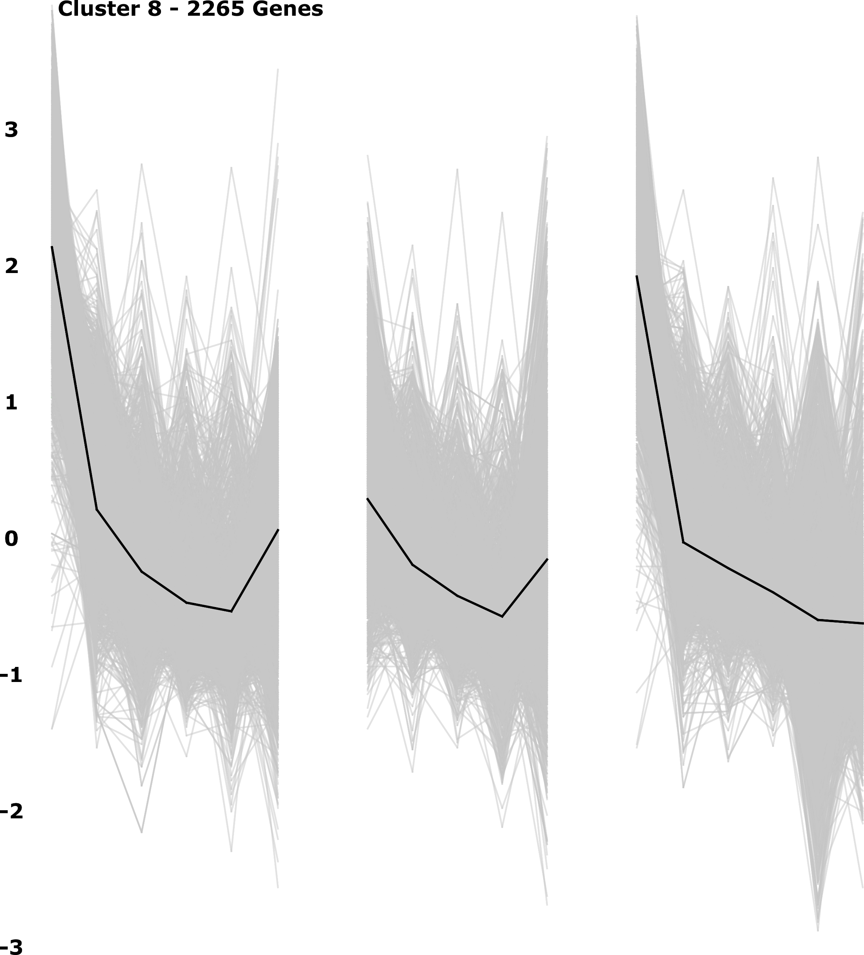
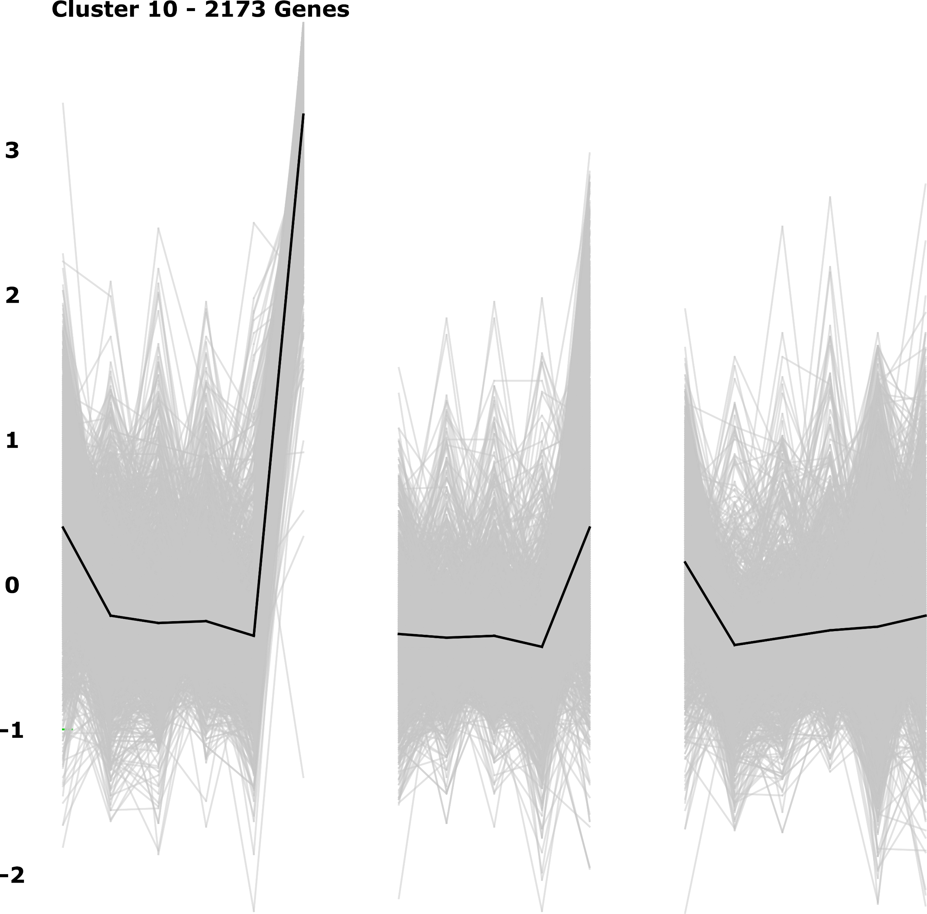
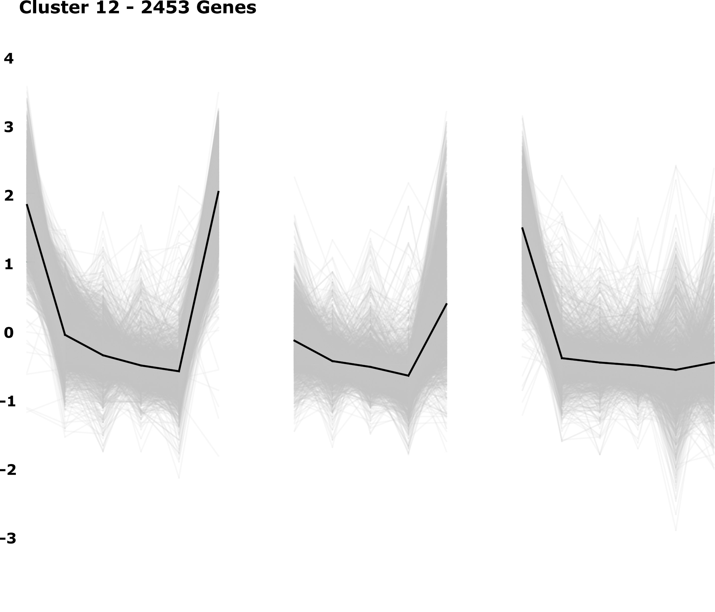
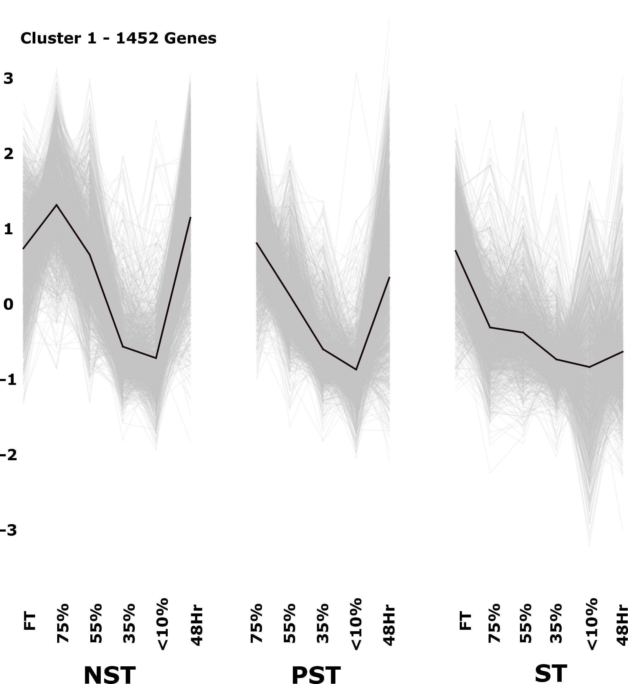
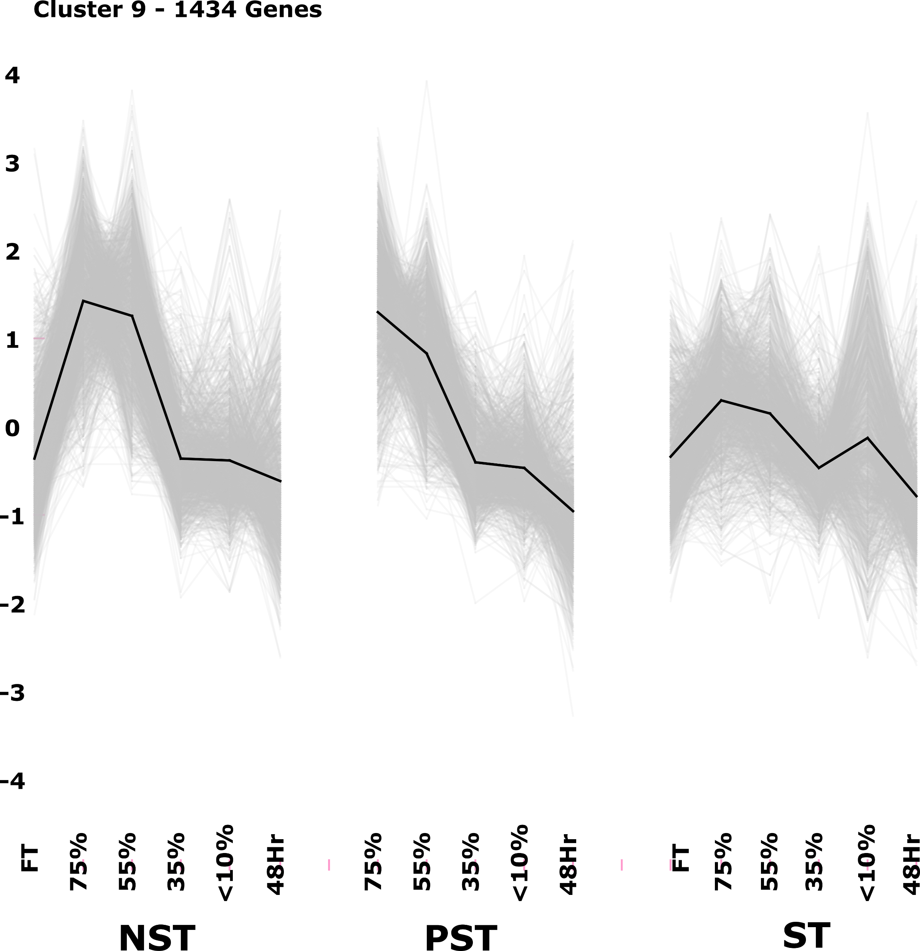
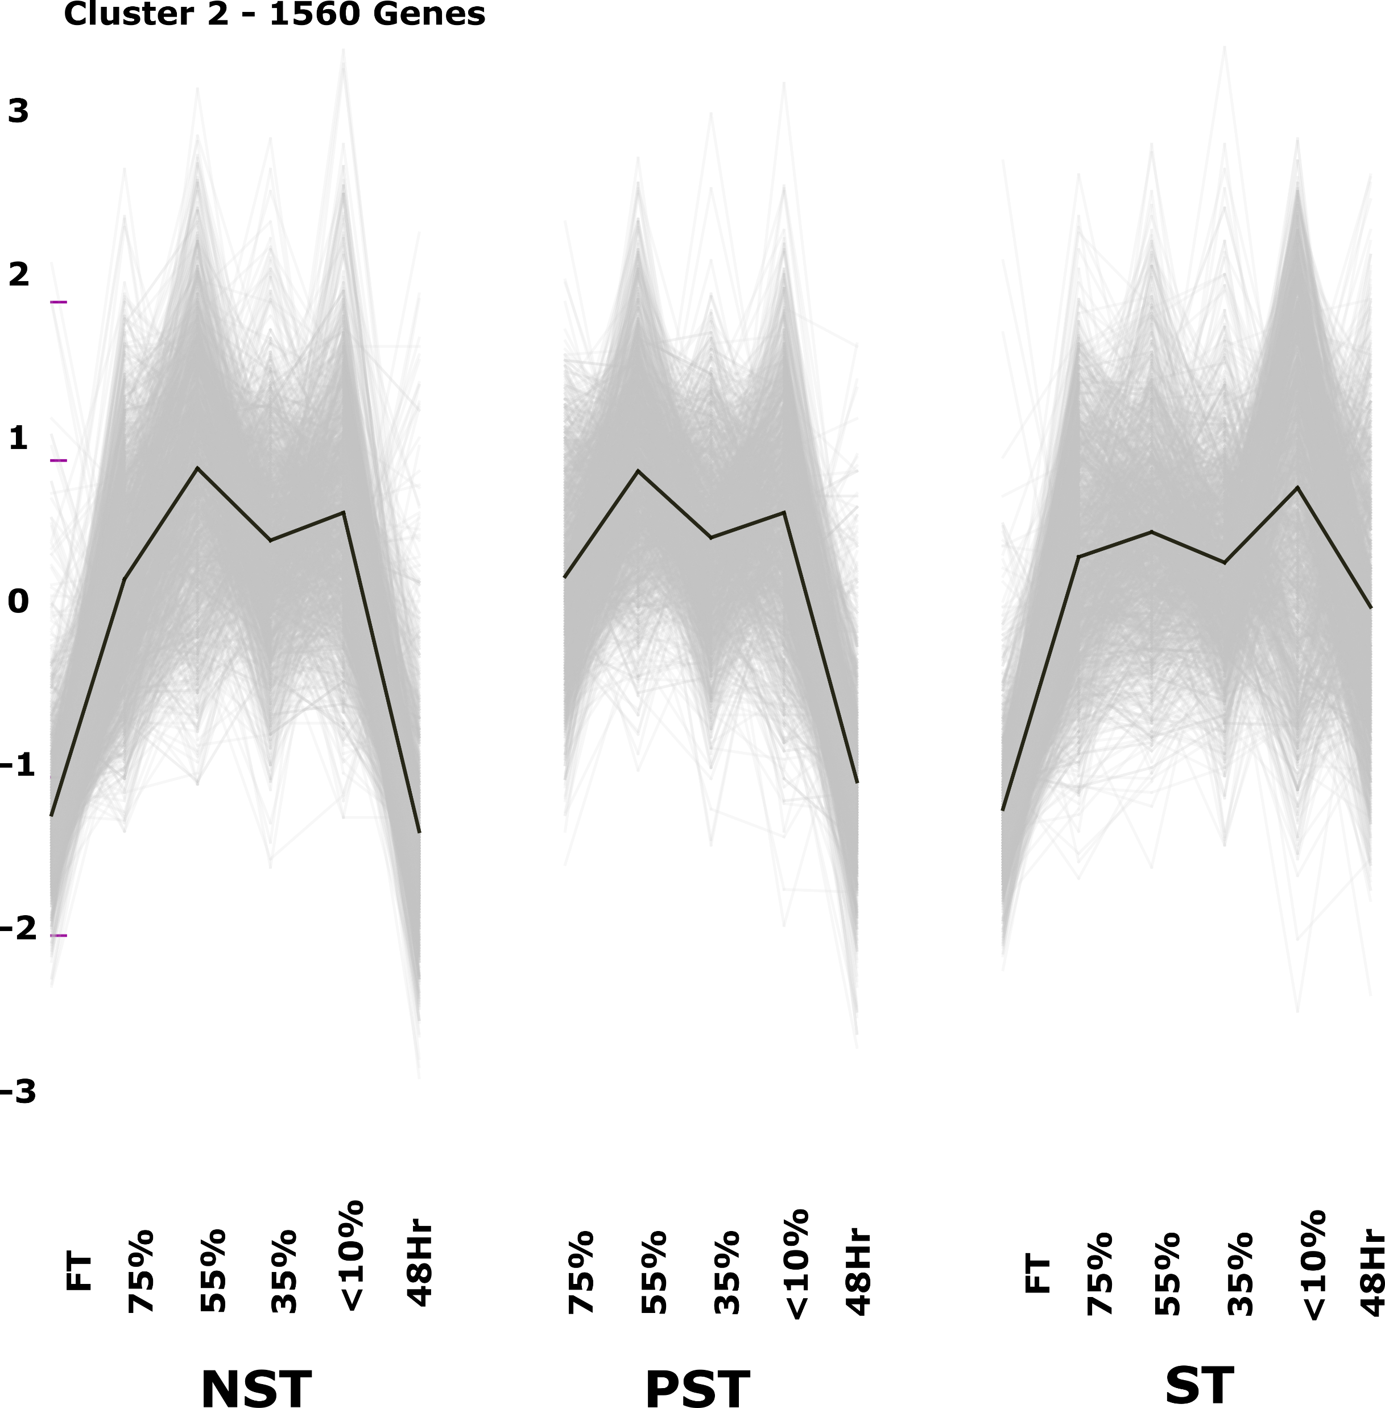
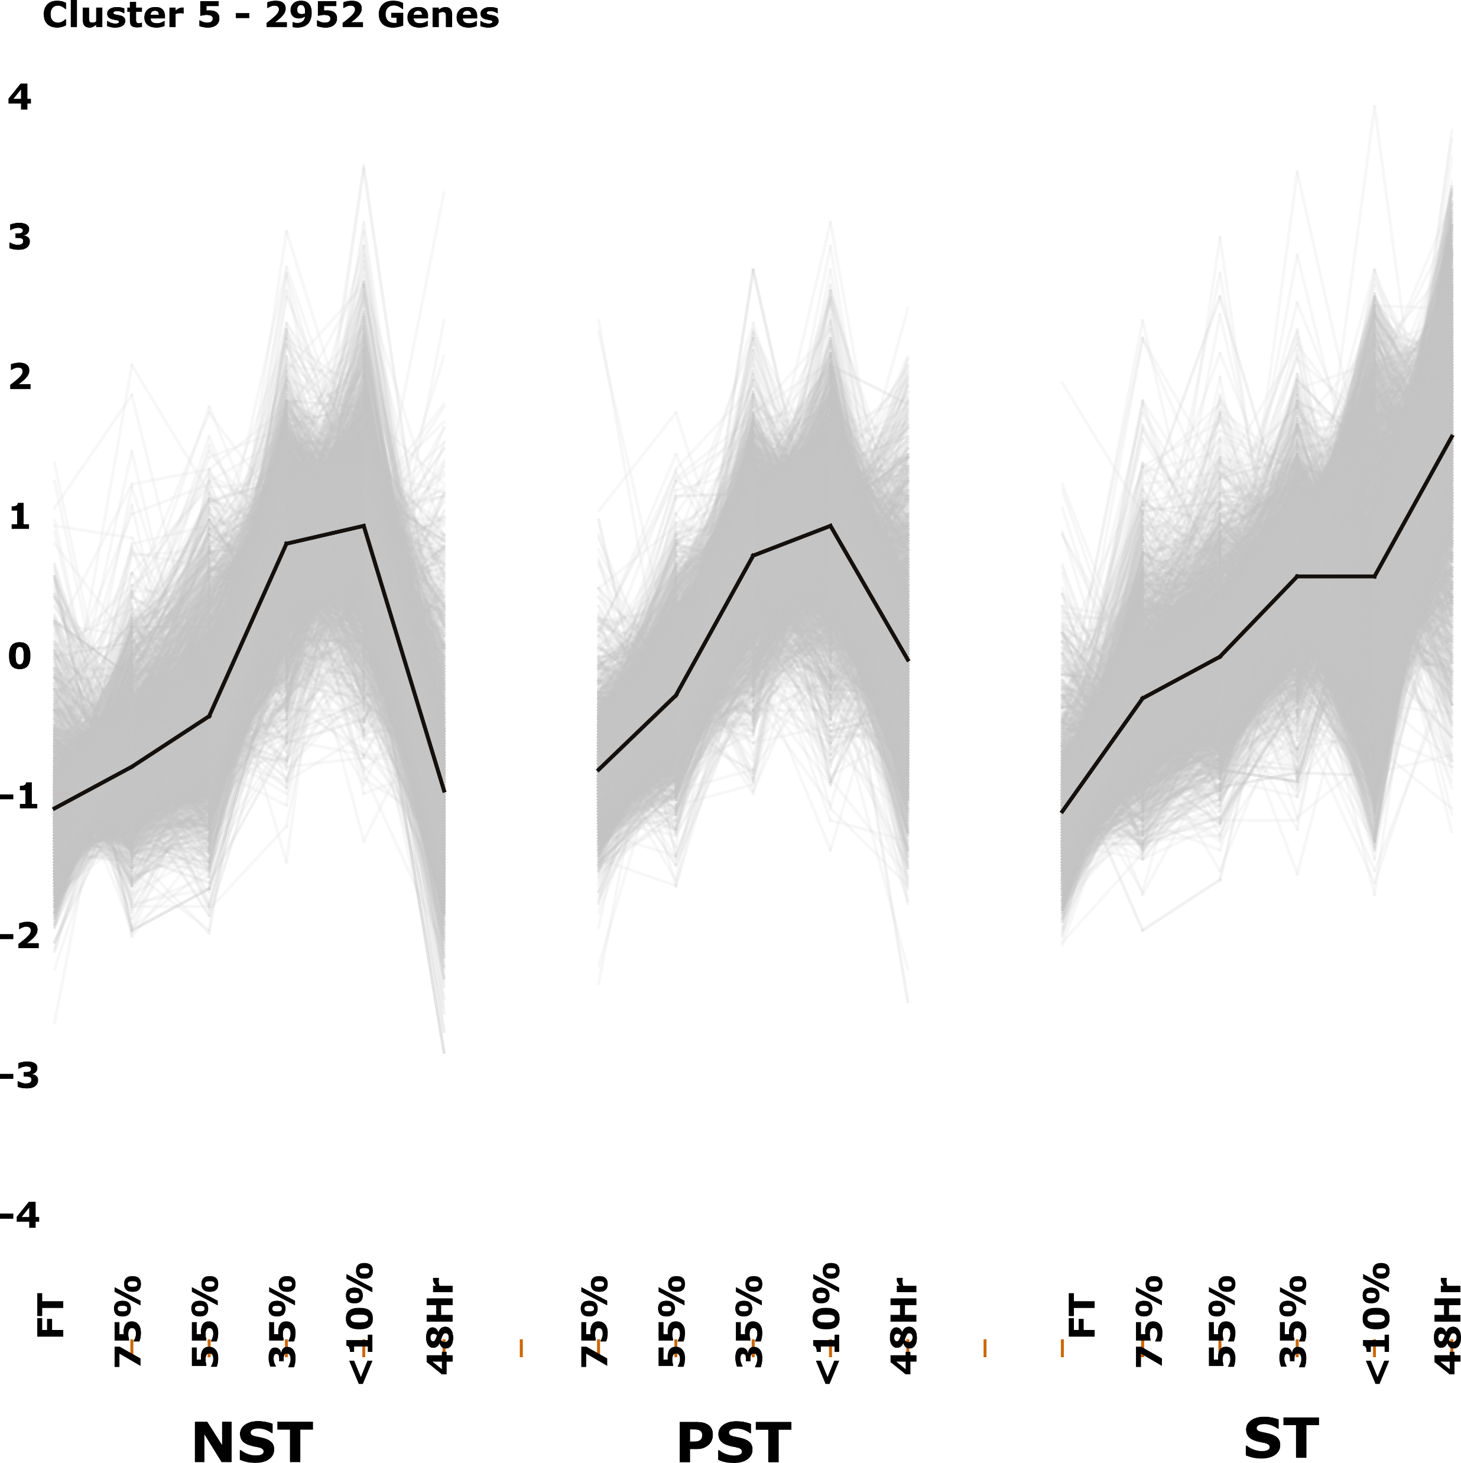
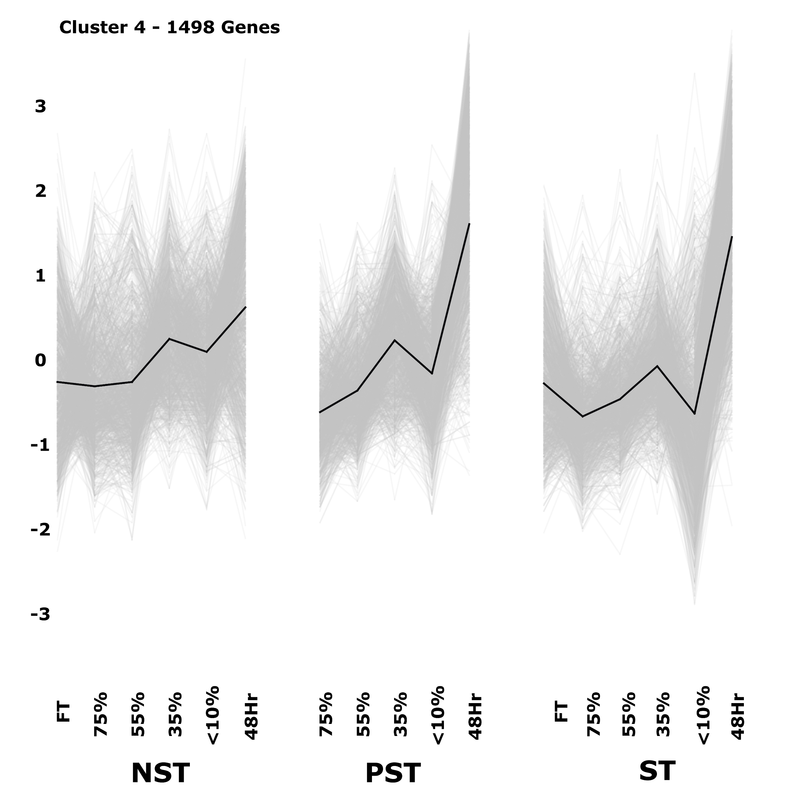
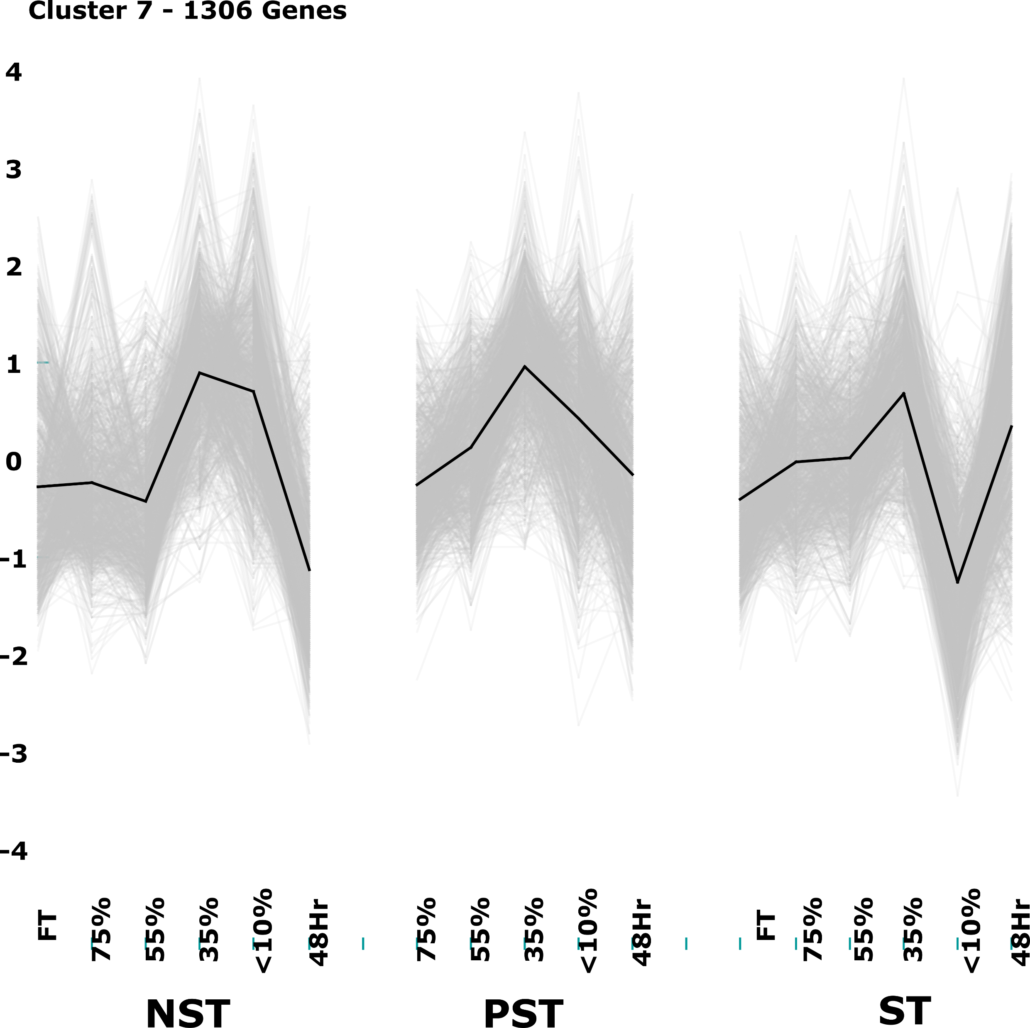
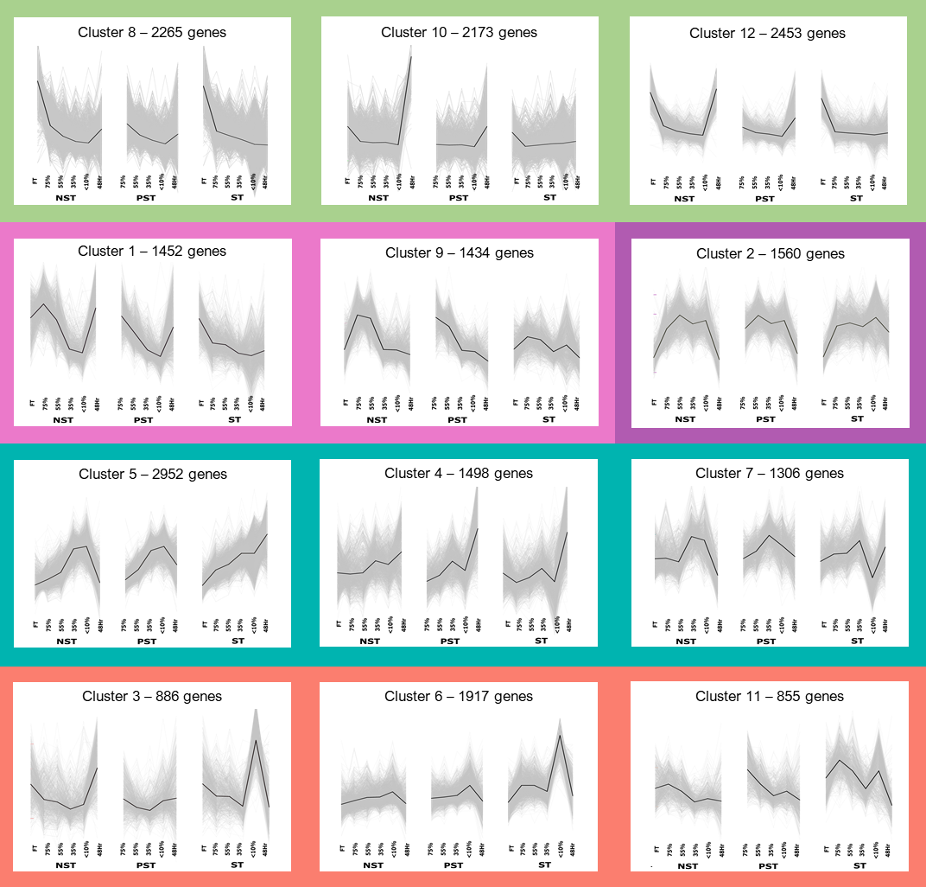
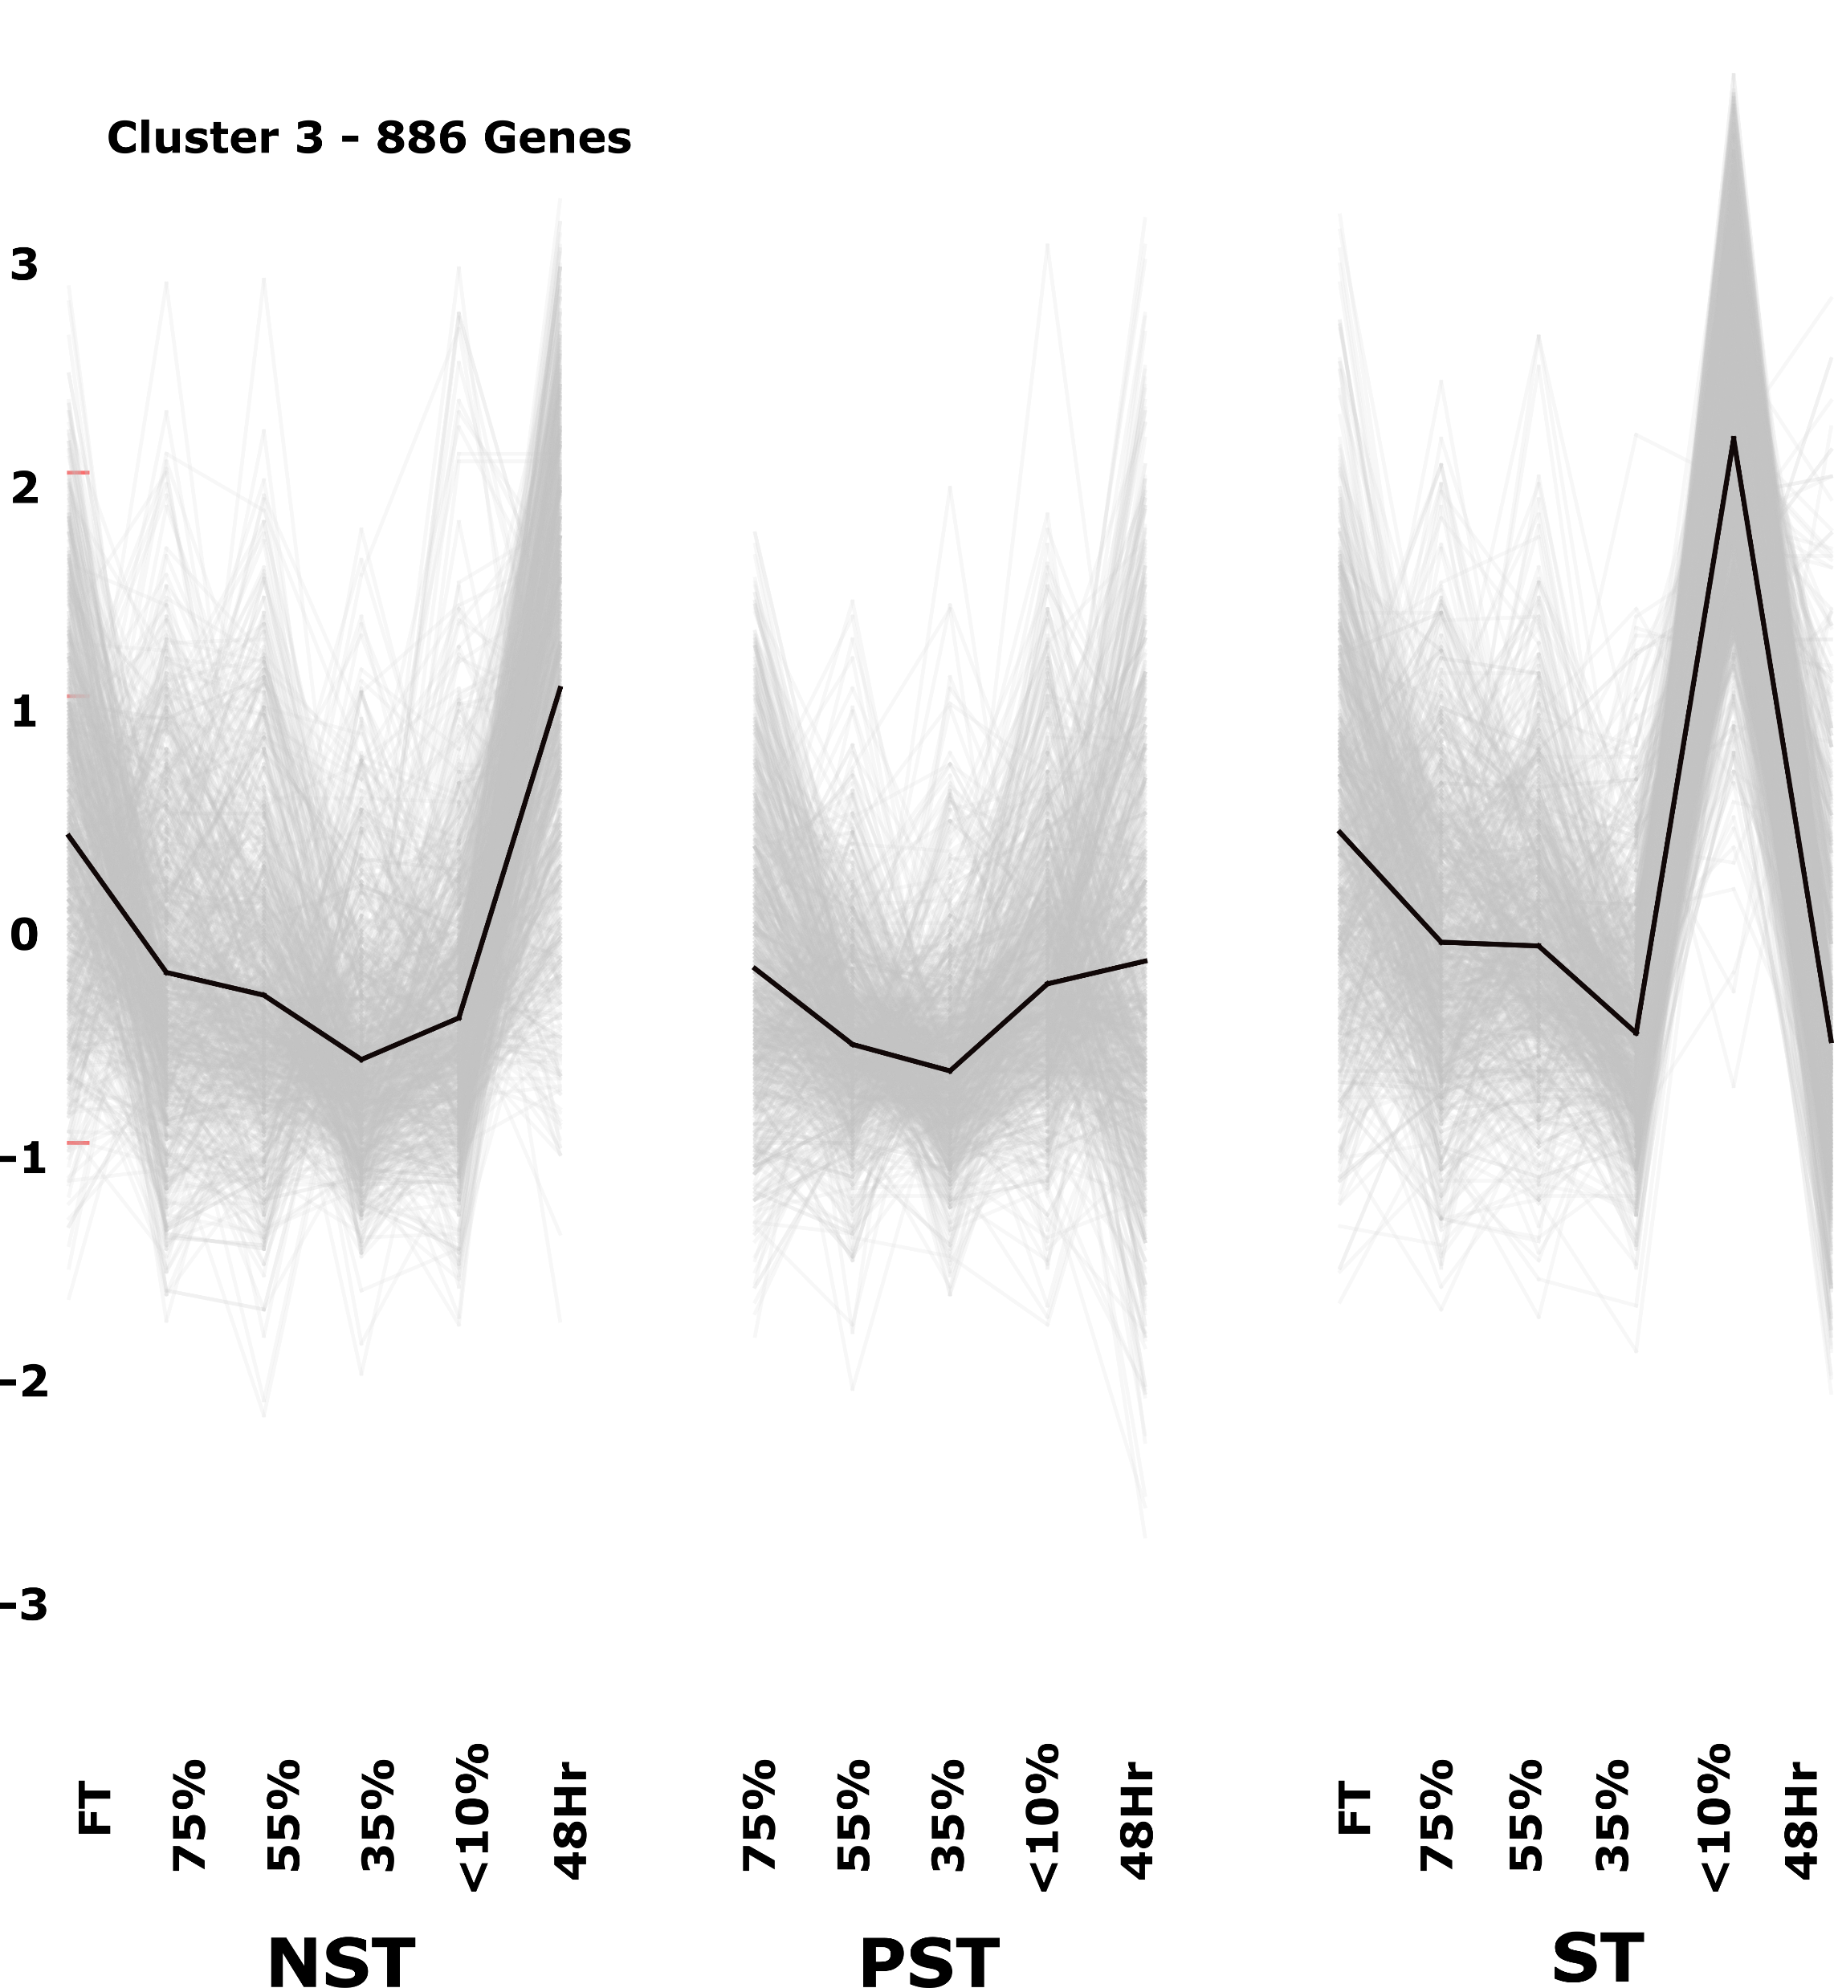
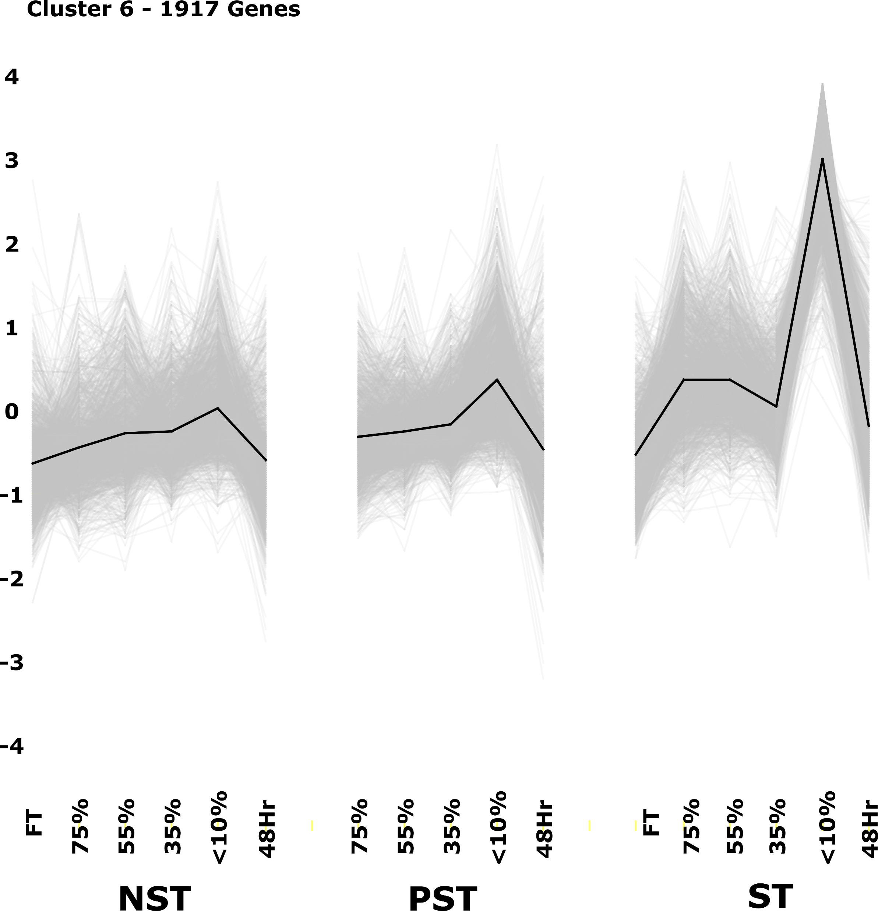
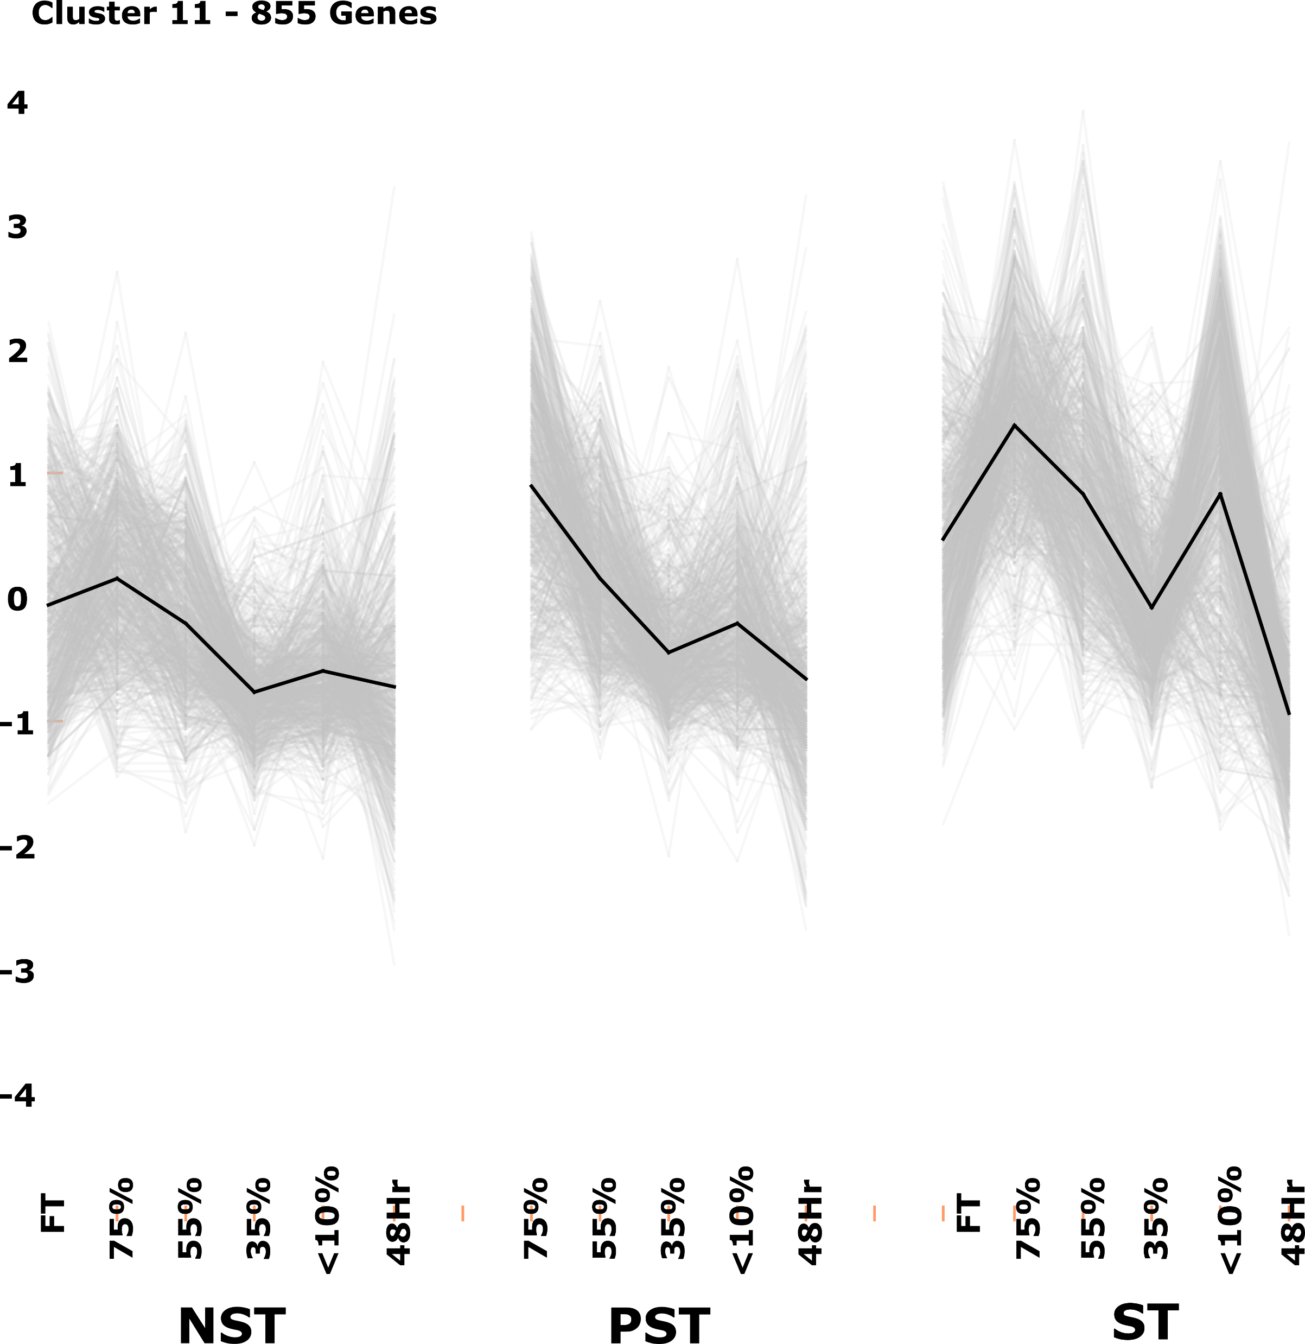
K-means Clustering
What are the patterns in gene expression between tissue types?
Cluster 8 – 2265 genes
Cluster 10 – 2173 genes
Cluster 12 – 2453 genes
Cluster 1 – 1452 genes
Cluster 9 – 1434 genes
Cluster 2 – 1560 genes
Cluster 5 – 2952 genes
Cluster 4 – 1498 genes
Cluster 7 – 1306 genes
Cluster 3 – 886 genes
Cluster 6 – 1917 genes
Cluster 11 – 855 genes
https://bioconductor.org/packages/release/bioc/html/TMixClust.html
Notes:
K-means clustering is an unsupervised machine learning technique that allows you to cluster data based on its pattern of expression. In this case, I grouped the time courses based on their tissue type and clustered them together so see tissue-specific changes in gene expression with time. I don’t have time to go in detail with describing each cluster, but I would just like to draw your attention to this orange band. This is the only cluster that is highly variable between the tissue types and these are the genes that are predominantly highly expressed in the senescent apical tissues at less than 20% RWC. So the greatest differences in gene expression between non-senescent and senescent tissue occurs at RWCs of lower than 20%. I used another method to confirm this finding – I correlated all of the genes with one another to create a network

Slide 11

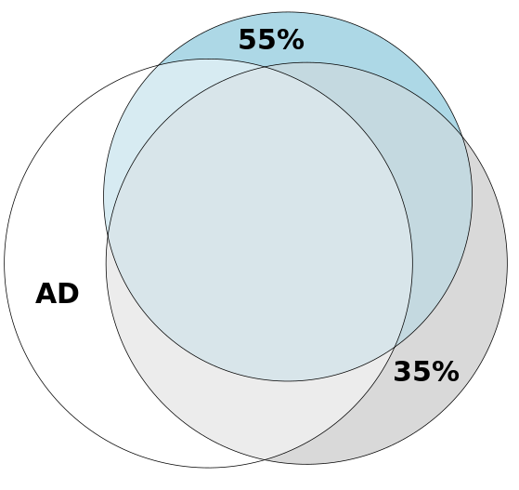
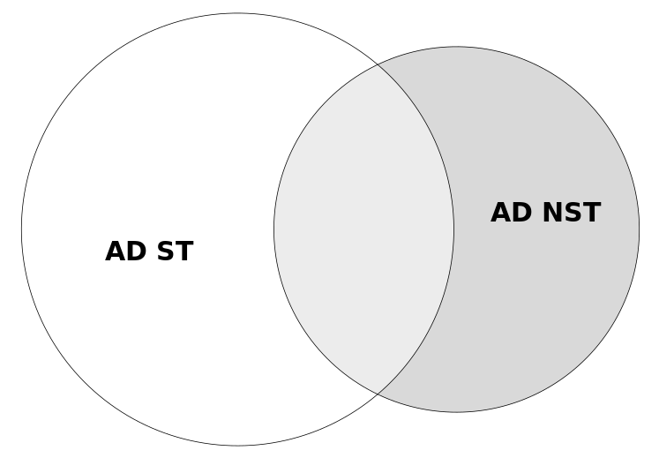
DEGs of interest: dissecting the senescence response from the desiccation response – comparing to FT NST is not particularly useful or meaningful because one cannot differentiate drought responsive genes from cellular death genes
Senescome
Only highly expressed in senescent tissue
Desiccome
Differentially expressed relative to hydrated surviving tissue
Part of desiccome

Slide 12
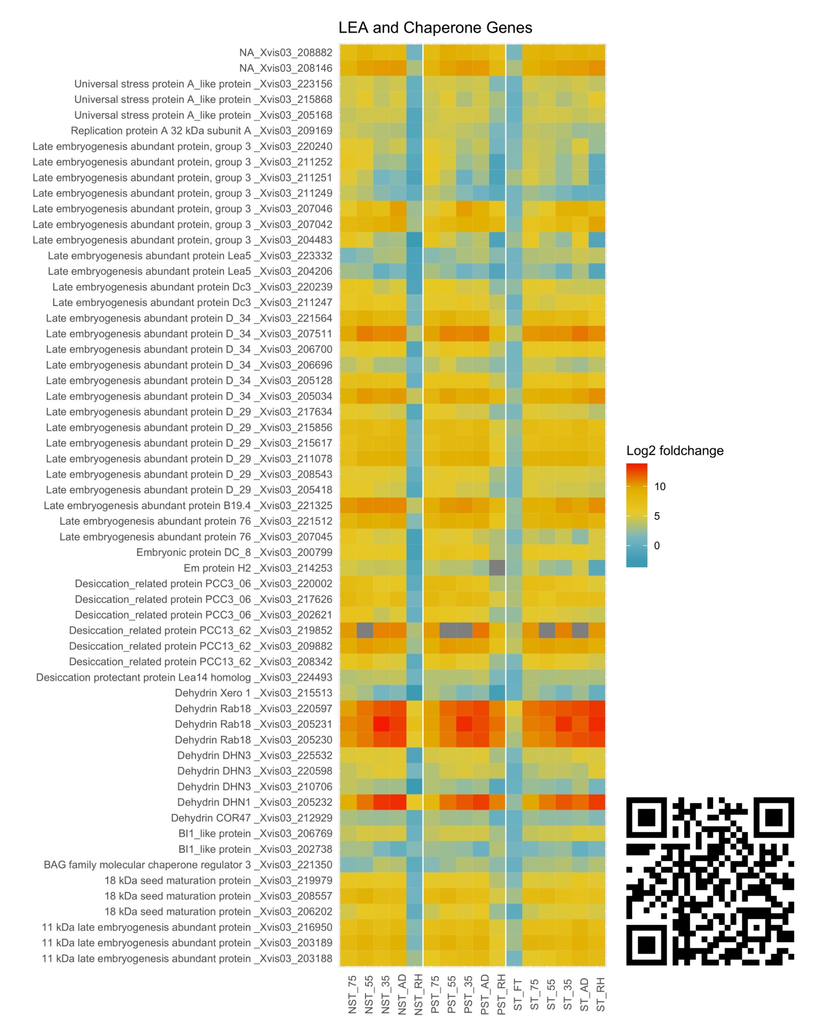


Desiccome: Cellular context for senescence
Desiccome = genes significantly accumulated in tissues below 55% RWC relative to FT NST
Classical DT mechanisms in full swing in all three tissue types:
LEAs, chaperone genes, anti-oxidants, stress responsive genes, lipid metabolism, etc.
ST has therefore not given up, but is a “bittereinder”
DT mechanisms in place when senescence is initiated
Desiccome
https://astridite.shinyapps.io/XeroDesiccome

Slide 13
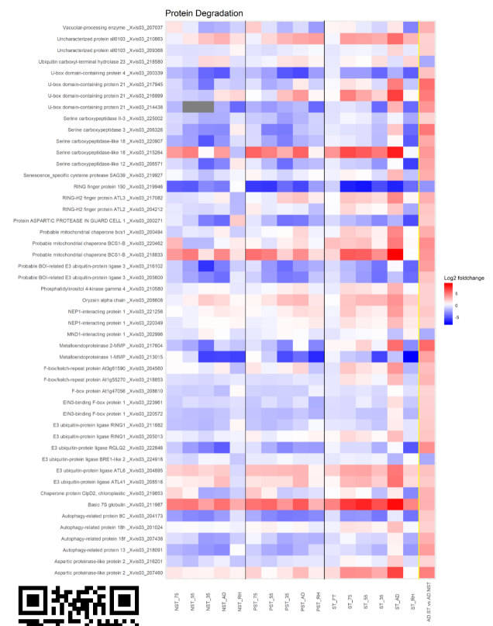
Senescome: extracting DEGs differentially accumulated in AD ST
“Greatest hits of death”:
Protein degradation, DNA cleavage,
cell death (ACD11, YLS), hormone binding and metabolism (ethylene and salicylic acid), transport (N, C, K, P)
Metabolism overdrive:
electron transport, Aox, beta-oxidation, fermentation
Senescome
Desiccome
https://astridite.shinyapps.io/XeroSenescome

Slide 14
So we have the genes responsible for cellular death, which are only expressed in the most extreme conditions, but how are they regulated?

Slide 15
How is expression of these senescence genes activated?
Promoter
Coding region
Are the senescence genes under the control of the same promoters?

Slide 16
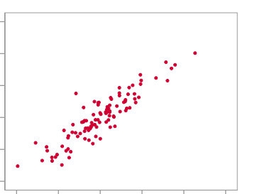
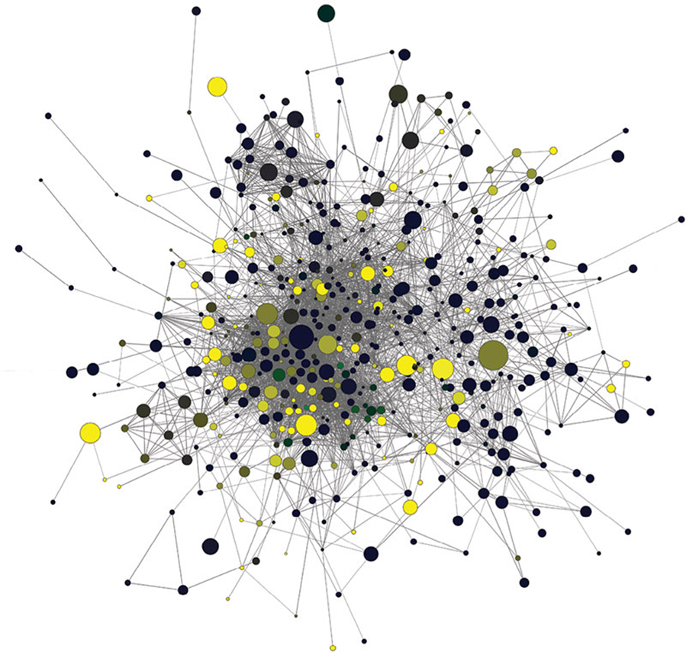
Co-expression Network Analysis
Which genes are highly correlated in terms of their expression and can we use this to find promoters?
FPKM gene 1
FPKM gene 2
PCC (R) ≥ 0.94
1
2
https://github.com/astridite/transcriptome_coexpression_network
Notes:
I used another method to confirm this finding – I correlated all of the genes with one another to create a network. So if you plot gene 1 vs gene 2, and their Pearson correlation is over 0.9, they are considered highly correlated. I set a threshold of 0.94 and only included genes that were correlated to this degree with at least one other gene. The distance between genes is determined by their correlation, and they are only connected if they meet this threshold. The result is this network where each gene is clustered closely with genes that behave very similarly in terms of their expression during desiccation. When coloured with the K-means clusters, it is apparent how the subnetworks naturally cluster based on their behaviour during desiccation. For the purposes of this talk, we are most interested in unravelling how this orange subnetwork is regulated, as these are the genes that are highly expressed in senescent tissue at low water contents.

Slide 17
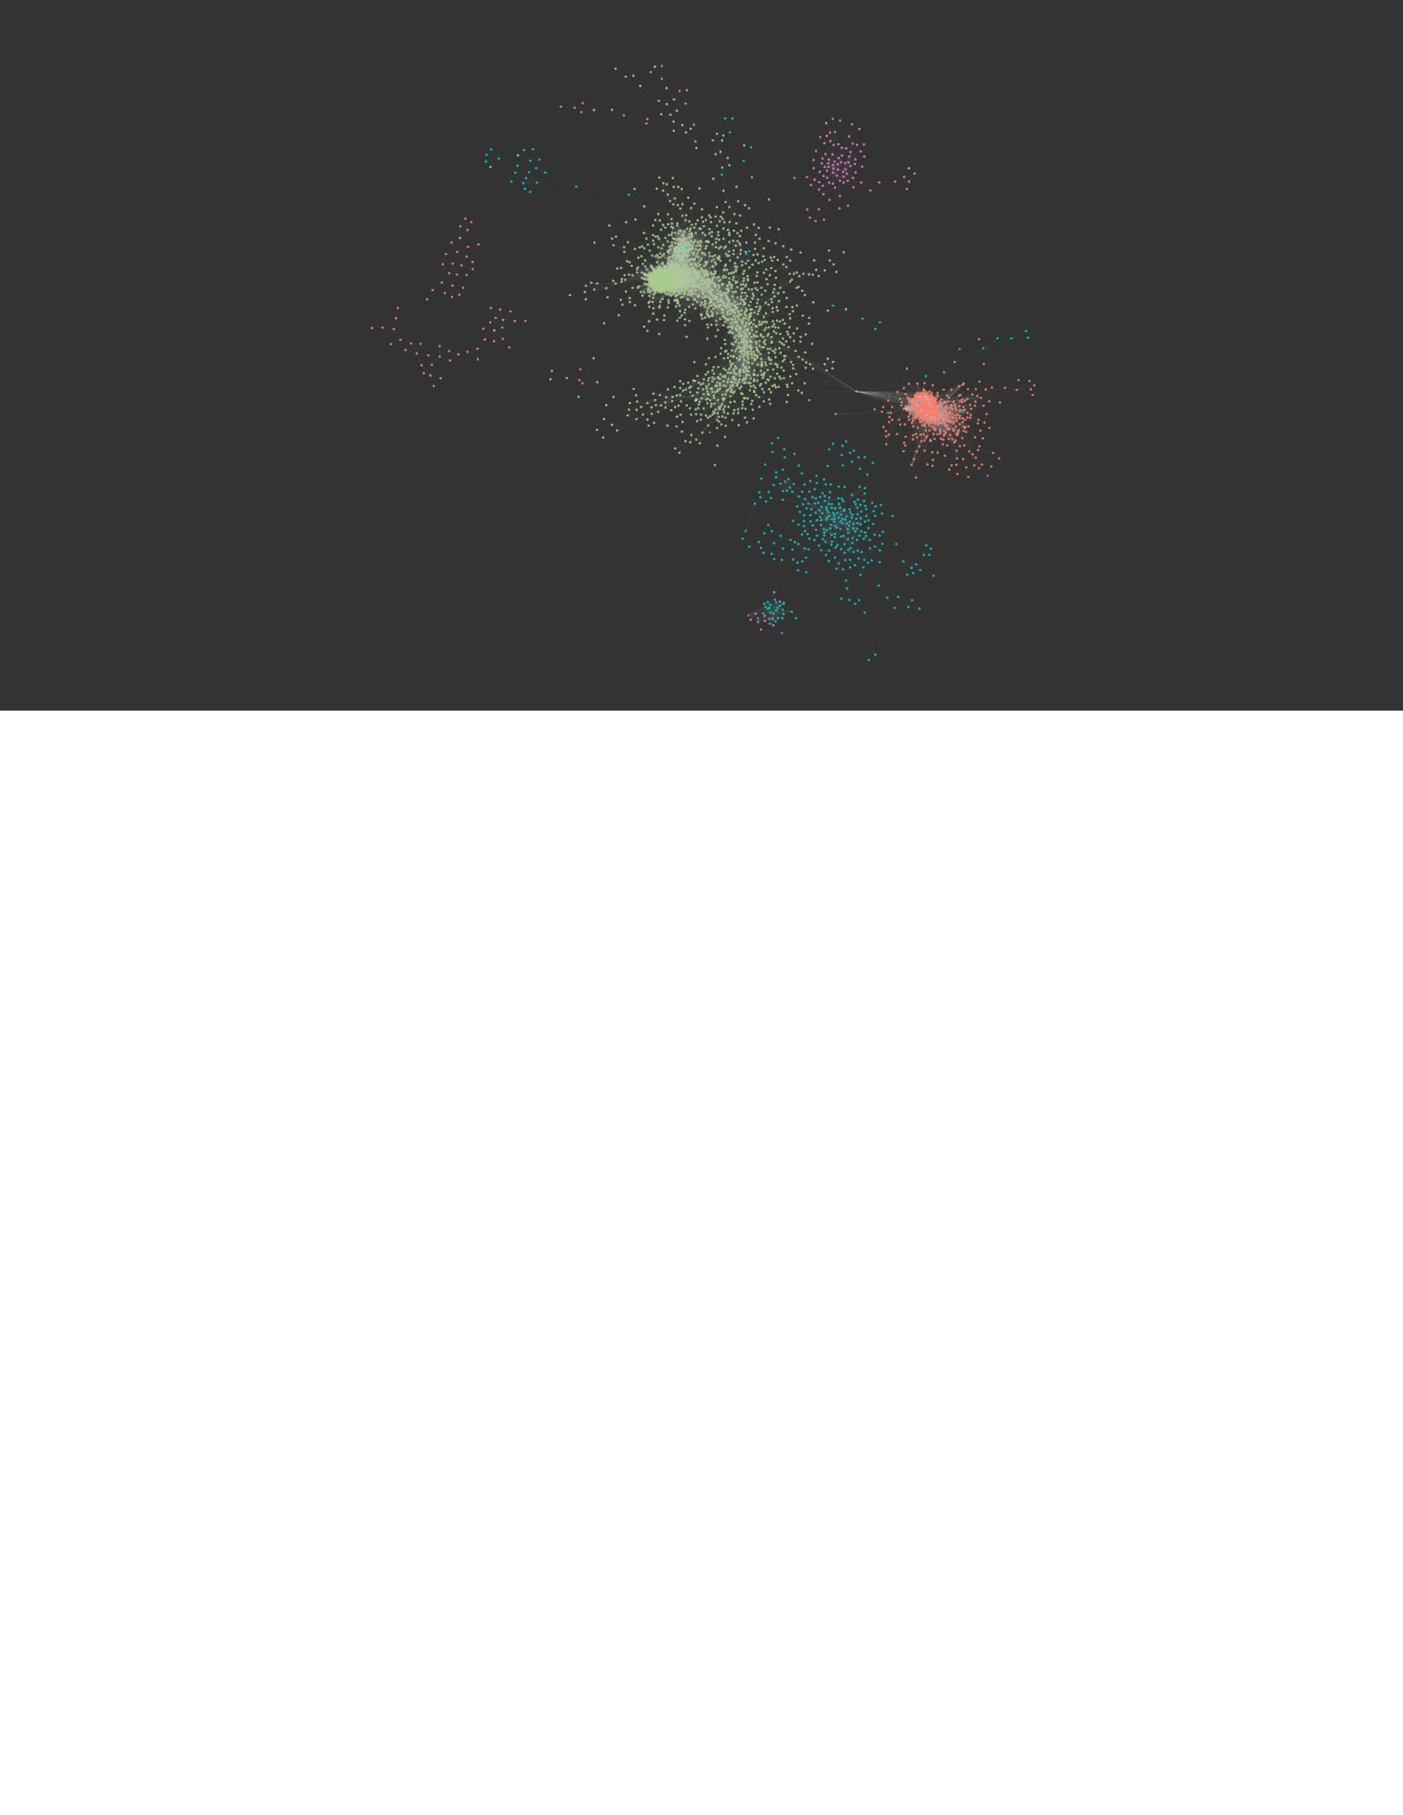
Co-expression Network Analysis
Which genes are highly correlated in terms of their expression and can we use this to find promoters?
Cluster 8 – 2265 genes
Cluster 10 – 2173 genes
Cluster 12 – 2453 genes
FPKM gene 1
Cluster 1 – 1452 genes
Cluster 9 – 1434 genes
Cluster 2 – 1560 genes
Cluster 5 – 2952 genes
Cluster 4 – 1498 genes
Cluster 7 – 1306 genes
FPKM gene 2
PCC (R) ≥ 0.94
Cluster 3 – 886 genes
Cluster 6 – 1917 genes
Cluster 11 – 855 genes
1
2
Notes:
I used another method to confirm this finding – I correlated all of the genes with one another to create a network. So if you plot gene 1 vs gene 2, and their Pearson correlation is over 0.9, they are considered highly correlated. I set a threshold of 0.94 and only included genes that were correlated to this degree with at least one other gene. The distance between genes is determined by their correlation, and they are only connected if they meet this threshold. The result is this network where each gene is clustered closely with genes that behave very similarly in terms of their expression during desiccation. When coloured with the K-means clusters, it is apparent how the subnetworks naturally cluster based on their behaviour during desiccation. For the purposes of this talk, we are most interested in unravelling how this orange subnetwork is regulated, as these are the genes that are highly expressed in senescent tissue at low water contents.

Slide 18
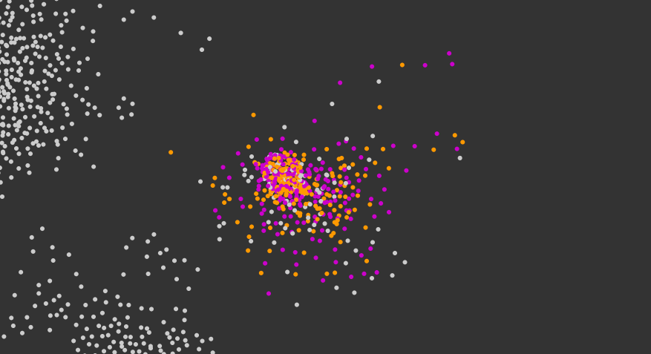
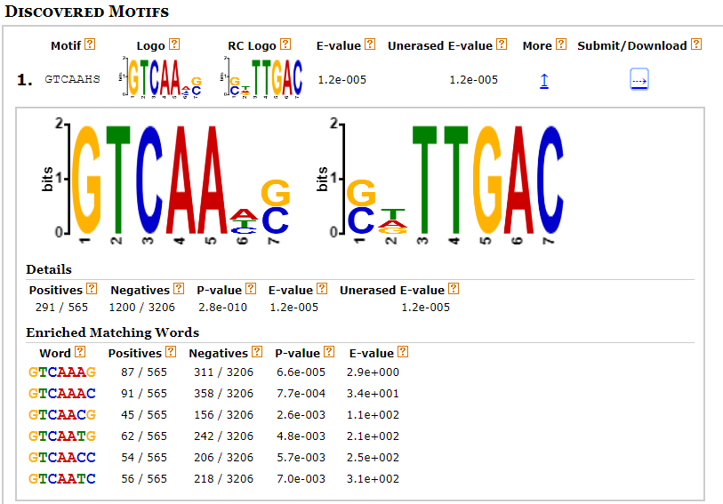
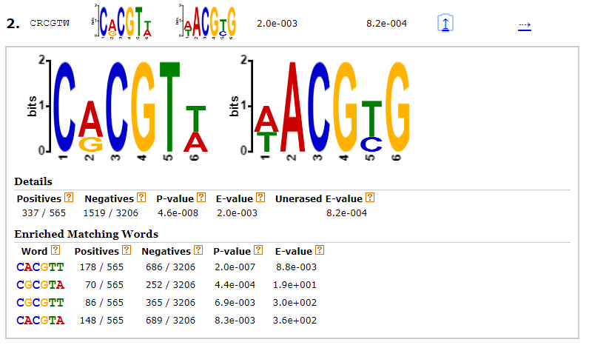
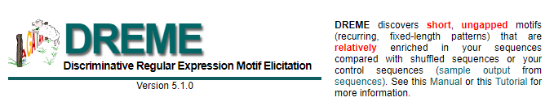
Promoter Analysis
How is expression of senescence genes regulated?
Promoter
GTCAAHS:
CRCGTW:
GTCAAHS & CRCGTW
GTCAAHS
Notes:
We are very fortunate in that there is a genome available for this species, so we are able to investigate the promoter regions of genes. This is where transcription factors bind to activate expression of genes. The sequence of the promoter regions can tell you a lot about what transcription factors might be regulating their expression. I used this programe called DREME which allows you to detect sequences of DNA that are enriched in the subnetwork relative to the promoter sequences of the whole network. This enabled me to detect two motifs, one with the sequence GTCAA.. And one with the sequence CRCGTW.

Slide 19
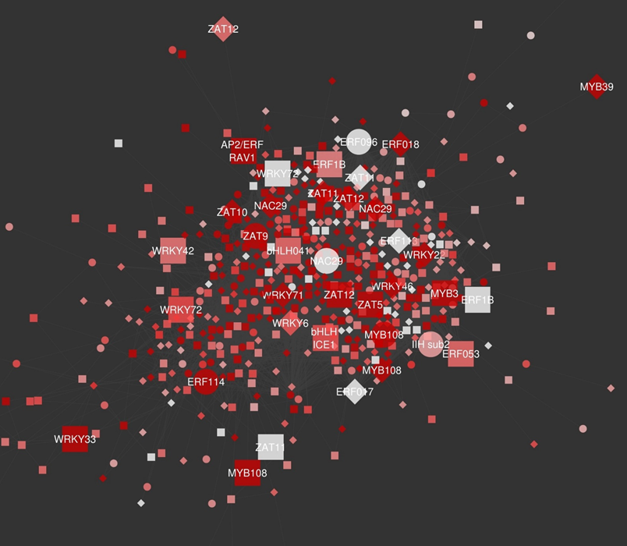
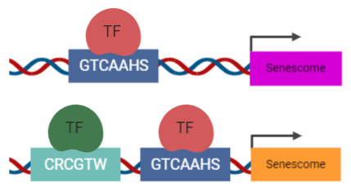
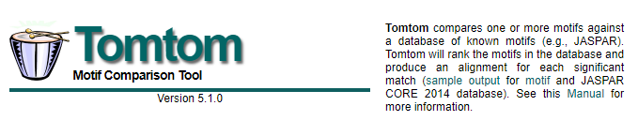
Transcription Factor Identification
Which TFs are controlling the network?
WRKY
bHLH
WRKY
Notes:
In the Meme suite, there is a database where motifs are matched to transcription factors that are known to bind to these sites. We got a list of genes that bind to these motifs and found the homologues that are in our subnetwork. These WRKY transcription factors are probably modulating expression of the whole network, and activating expression of most of the senescence genes. The only transcription factor found to bind to the C motif that was also in our network is a bHLH transcription factor, that is not very well described.

Slide 20
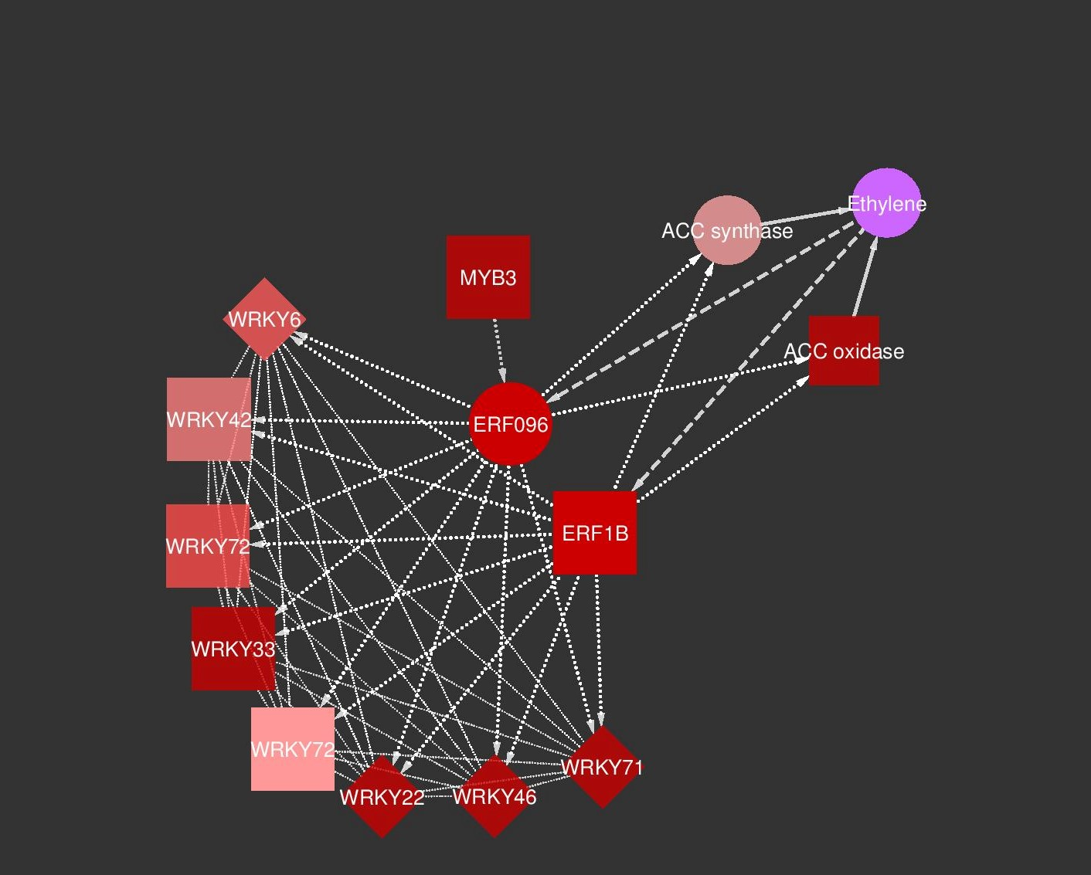
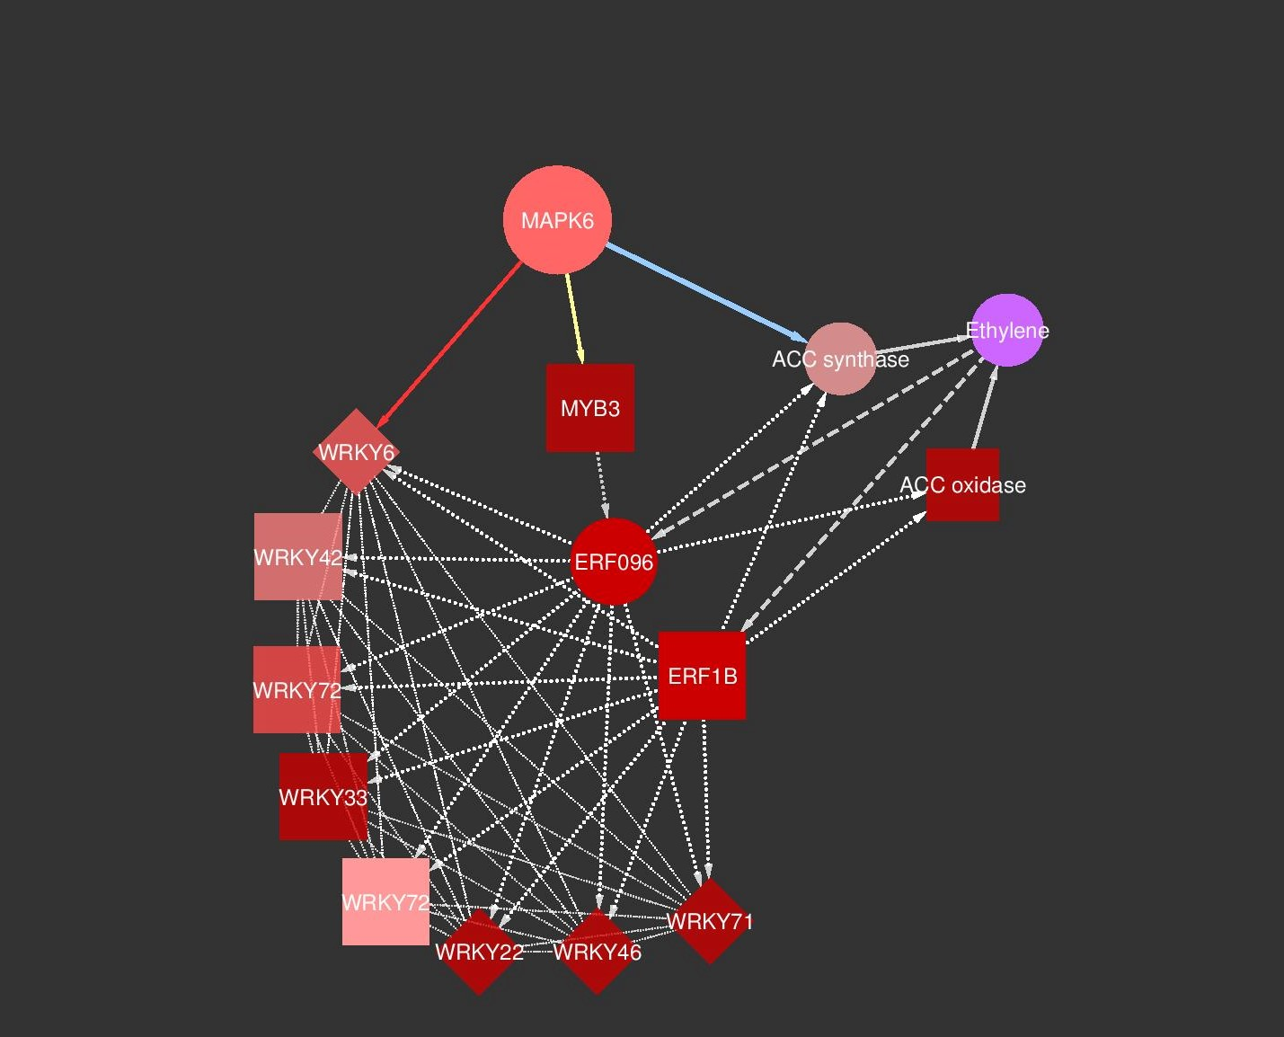
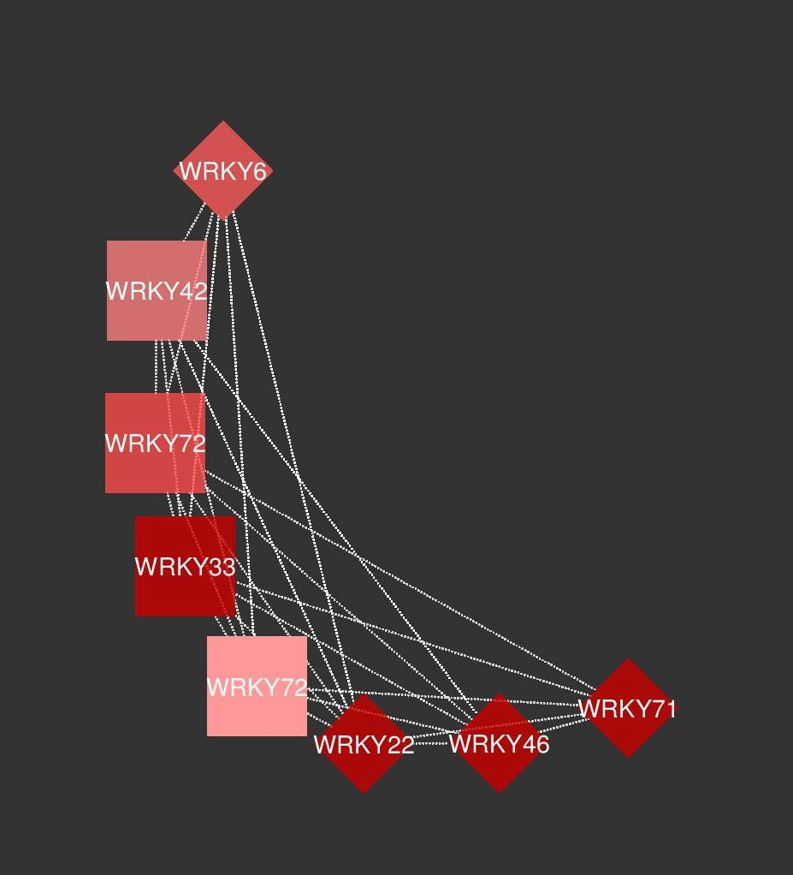
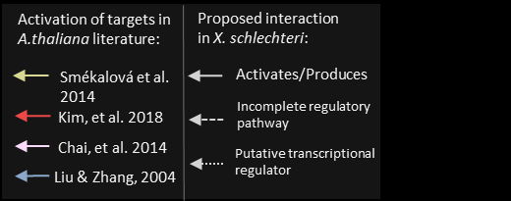
Predicted Cell Death Regulation Model
Notes:
I then went to the literature to see what might be activating these proteins to influence their activity in this signalling pathway. MAPK6 is a kinase that acts in response to a myriad of abiotic stressors to influence gene expression, and has been found to activate WRKY6, MYB3 and acc synthase in Arabidopsis thaliana. It is also highly expressed in the senescent tissue at low water contents, making it a good candidate.

Slide 21
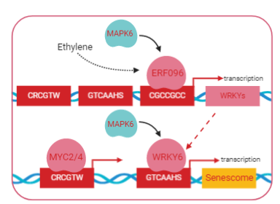

Future work:
Testing this model experimentally.
If indeed the model holds – how are these cellular death genes repressed in non-senescent tissues?

Slide 22





Thank You!
Prof Jill Farrant
Assoc. Prof Henk Hilhorst
Dr Suhail Rafudeen
Keren Cooper
Dr Amelia Hilgart
Pei-Yin Liebrich
Arno Duvenage
Halford Dace
Arash Iranzadeh
Dr Maria Cecilia Dias Costa
Plant Stress Lab peeps
Prof Sagadevan Mundree
Dr Brett Williams
Electron Microscopy Unit, UCT – Miranda Waldron and Mohamed Jafer
John Burroughs – Buffelskloof nature reserve
R consortium for funding this trip
Find me on github/shiny:
astridite
Find me on research gate:
Astrid Lillie Radermacher
Find me on twitter:
@dataccino

